Slide 1

Java 13 New Features
Dima Ionut Daniel

Slide 2
Contents
What is Java?
History
Java Flavors
New Features
Core
Other Improvements
Bibliography

Slide 3

What is Java?
Java is a programming language created by Sun Microsystems.
Java is used in a wide variety of computing platforms from embedded devices and mobile phones on the low end, to enterprise servers and supercomputers on the high end.
Memory management is handled through integrated automatic garbage collection performed by the JVM.
The heart of the Java platform is the concept of a "virtual machine" that executes Java bytecode programs. This bytecode is the same no matter what hardware or operating system the program is running under.
There is a JIT(Just-In-Time) compiler within the Java Virtual Machine, or JVM. The JIT compiler translates the Java bytecode into native processor instructions at run-time and caches the native code in memory during execution.
The Java programs are cross-platform or platform independent, but the code of the Java Virtual Machines (JVM) that execute these programs is not.

Slide 4
History
The initial Java release was named Oak, and the first stable version was JDK 1.0.2, called Java 1.
JDK 1.0 - 23 January 1996
JDK 1.1 – 19 February 1997
J2SE 1.2 – 8 December 1998 (codename Playground)
J2SE 1.3 – 8 May 2000 (codename Kestrel)
J2SE 1.4 – 6 February 2002 (codename Merlin)
J2SE 5.0 – 30 September 2004 (codename Tiger)
Java SE 6 – 11 December 2006 (codename Mustang)
Java SE 7 – 7 July 2011(codename Dolphin)
Java SE 8 – 18 March 2014 (codename Spider)
Java SE 9 – 21 September 2017
Java SE 10 – 20 March 2018
Java SE 11 – 25 September 2018
Java SE 12 – 19 March 2019
Java SE 13 – 17 September 2019

Slide 5
Java Flavors
The Java distribution comes in different flavors:
Java Card →run securely on smart cards and similar small-memory devices.
Java ME(Micro Edition) → Specifies several different sets of libraries (known as profiles) for devices with limited storage, display, and power capacities.
Java SE(Standard Edition) → for general-purpose use on desktop PCs, servers and similar devices.
Java EE(Enterprise Edition) → Java SE plus various APIs useful for multi-tier client–server enterprise applications.

Slide 6
New Features
JEP 354 - Switch Expressions (Second Preview)
JEP 355 - Text Blocks (Preview)
JEP 351 - ZGC: Uncommit unused memory
JEP 350 - Dynamic CDS Archives
JEP 353 - Reimplement the Legacy Socket API
Support for Unicode 12.1

Slide 7
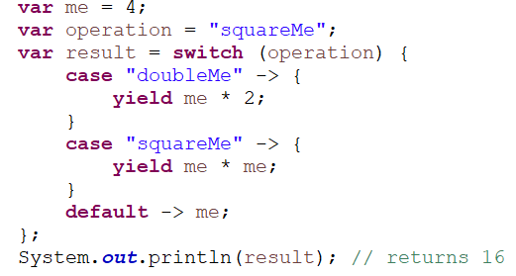
Core
Using yield, we can now effectively return values from a switch expression

Slide 8
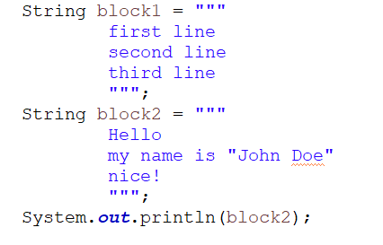
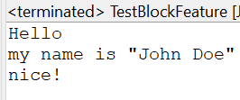
Core (cont.)
The text blocks feature for multi-line Strings such as embedded JSON, XML, HTML, etc was introduced.
There is no need to escape double quotes or to add a carriage return.
By using text blocks, the embedded JSON is much simpler to write and easier to read and maintain.

Slide 9
Core (cont.)
java.lang.String now has three new methods to manipulate text blocks:
stripIndent() – mimics the compiler to remove incidental white space
translateEscapes() – translates escape sequences such as “\\t” to “\t”
formatted() – works the same as String::format, but for text blocks

Slide 10
Core (cont.)
New methods have been added for instantiating DOM and SAX factories with Namespace support by default. These methods are prefixed over their existing counterparts with “NS,” which stands for NamespaceAware.
newDefaultNSInstance()
newNSInstance()
newNSInstance(String factoryClassName, ClassLoader classLoader)
DocumentBuilder db = DocumentBuilderFactory.newDefaultNSInstance().newDocumentBuilder();
is equivalent to:
DocumentBuilderFactory dbf = DocumentBuilderFactory.newDefaultInstance();
dbf.setNamespaceAware(true);
DocumentBuilder db = dbf.newDocumentBuilder();

Slide 11
Core (cont.)
The class-data-sharing feature was introduced in Java 10, is extended in this JEP 350.
It's now much easier to create a CDS archive and to use it.
$ java -XX:ArchiveClassesAtExit=my_app_cds.jsa -cp my_app.jar
$ java -XX:SharedArchiveFile=my_app_cds.jsa -cp my_app.jar

Slide 12
Core (cont.)
Java 13 has given us a few more notable changes:
java.nio – method FileSystems.newFileSystem(Path, Map<String, ?>) added
java.time – new official Japanese era name added
javax.crypto – support for MS Cryptography Next Generation (CNG)
javax.security – property jdk.sasl.disabledMechanisms added to disable SASL mechanisms
javax.xml.crypto – new String constants introduced to represent Canonical XML 1.1 URIs
javax.xml.parsers – new methods added to instantiate DOM and SAX factories with namespaces support
Unicode support upgraded to version 12.1
Support added for Kerberos principal name canonicalization and cross-realm referrals.

Slide 13
Other Improvements
Class data sharing (CDS) has been a prominent feature of Java HotSpot VM for a while now.
It allows class metadata to be shared across different JVMs to reduce startup time and memory footprint.
JDK 10 extended this ability by adding application CDS (AppCDS) to give developers the power to include application classes in the shared archive.

Slide 14
Other Improvements (cont.)
The underlying implementation of the java.net.Socket and java.net.ServerSocket APIs have been rewritten.
The new implementation, NioSocketImpl, is a drop-in replacement for PlainSocketImpl.
It uses java.util.concurrent locks rather than synchronized methods.
To use the legacy implementation,we need to use the java option -Djdk.net.usePlainSocketImpl.

Slide 15
Other Improvements (cont.)
The Z Garbage Collector was introduced in Java 11 as a low-latency garbage collection mechanism, such that GC pause times never exceeded 10 ms. However, unlike other HotSpot VM GCs such as G1 and Shenandoah, it was not equipped to return unused heap memory to the operating system. Java 13 added this capability to the ZGC.
Starting with Java 13, the ZGC now returns uncommitted memory to the operating system by default, up until the specified minimum heap size is reached. If we do not want to use this feature, we can go back to the Java 11 way by:
Using option -XX:-ZUncommit, or
Setting equal minimum (-Xms) and maximum (-Xmx) heap sizes
Additionally, ZGC now has a maximum supported heap size of 16TB. Earlier, 4TB was the limit.

Slide 16
Other Improvements (cont.)
The java.net.Socket and java.net.ServerSocket APIs, and their underlying implementations, date back to JDK 1.0.
The implementation is a mix of legacy Java and C code that is painful to maintain and debug.
The implementation uses the thread stack as the I/O buffer, an approach that has required increasing the default thread stack size on several occasions.
In Java 13 version this will be replaced by a simpler and more modern implementation that is easy to maintain and debug.
The new implementation will be easy to adapt to work with user-mode threads, a.k.a. fibers.

Slide 17
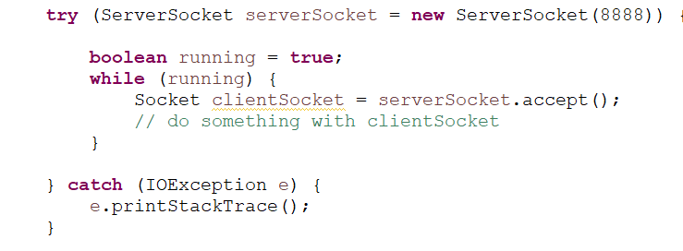
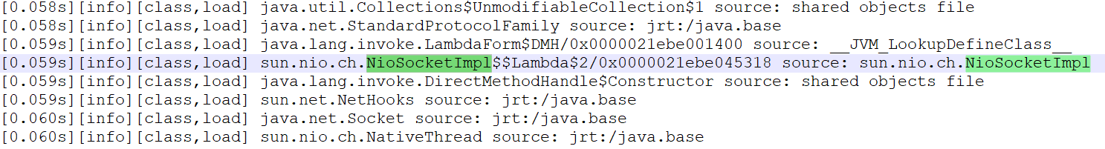
Other Improvements (cont.)
We can check loaded classes at runtime using the -XX:+TraceClassLoading argument (was removed from JDK 16), or -Xlog:class+load=info .

Slide 18

Bibliography
http://en.wikipedia.org/wiki/Java_(programming_language)
https://www.baeldung.com/java-13-new-features https://examples.javacodegeeks.com/the-new-features-in-java-13/
https://www.digitalocean.com/community/tutorials/java-13-features

